Slide 1
MONASH INFORMATION
TECHNOLOGY
Machine Learning:
Collaborative Filtering
Prajwol Sangat
Updated by Chee-Ming Ting (30 April 2021)

Slide 2
Last week
Clustering:
K-Means
Parallel K-Means

Slide 3
This week
Collaborative Filtering

Slide 4
Recommender System
A recommender system makes prediction based on users’ historical behaviours. More specifically, it predicts user preference for a set of items based on past experience. This system is personalizing user’s web experience – e.g. telling what to buy (Amazon), which movies to watch (Netflix), whom to be friends with (Facebook), which songs to listen (Spotify) etc.
Two common approaches:
Content based
Collaborative Filtering

Slide 5
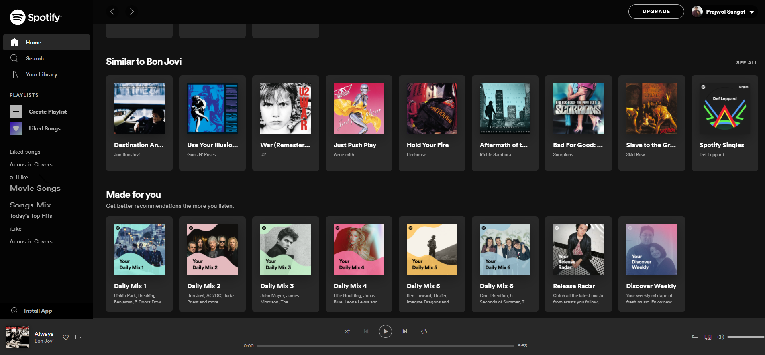
Everyday Examples of Collaborative Filtering

Slide 6
User feedback
Explicit feedback: Direct preferences given by the user to the item (e.g., user rating)
Implicit feedback : Indirect feedback, gathered from user behaviour (e.g. number of views, clicks, shares, likes, visited/brought objects etc.).
Image from: https://www.slideshare.net/LadislavPeska/using-the-context-of-user-feedback-in-recommender-systems
Notes:
So as you can imagine there are two types of feedback.
First one is explicit feedback.
Explicit feedback is basically direct feedback you give or the user gives for a particular item.
For example a rating to a movie or song or image.
Implicit feedback is indirect.
For example, number of views, clicks, likes and shares and so on.
So, there are two types of feedback here.

Slide 7
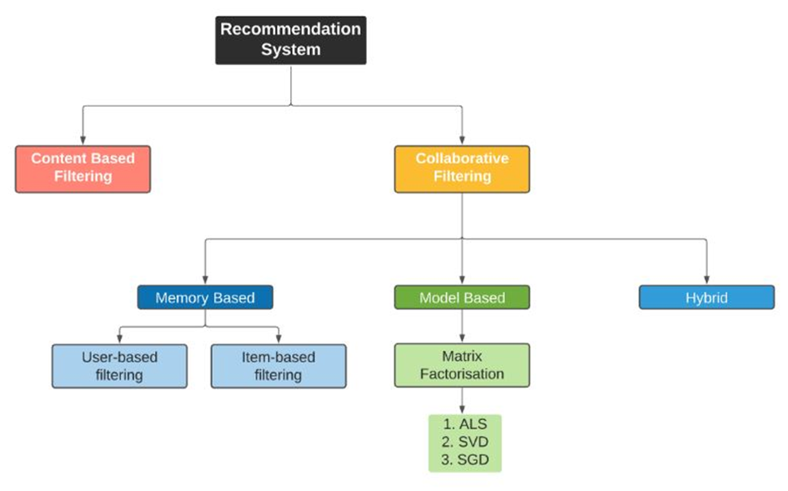
Recommender System
Two common approaches:
Content based
Collaborative Filtering
Collaborative filtering is a method of making automatic predictions (filtering) about the interests of a user by collecting preferences from many users (collaborating)
https://towardsdatascience.com/build-recommendation-system-with-pyspark-using-alternating-least-squares-als-matrix-factorisation-ebe1ad2e7679
Notes:
What are the driving algorithms behind the recommendation system.
That will be either one of this.
One is content based and the other one is collaborative filtering.

Slide 8
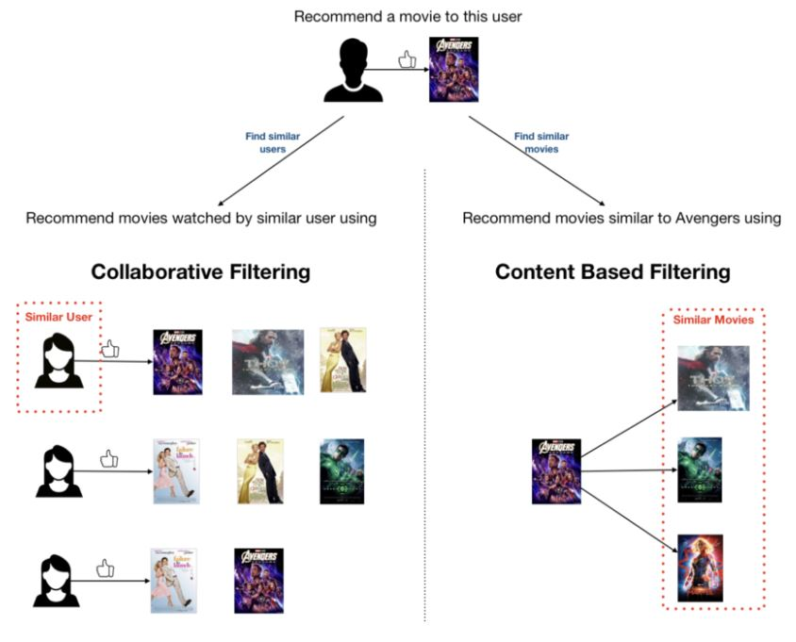
Content based Filtering
Main Idea: Recommend items similar to the items previously liked by the user
Example:
Movie recommendations: Recommend movies with same actor(s), director, genre.
Websites, blogs, news: Recommend other sites with “similar” content
It requires a sufficient amount of information about the content of the items
https://towardsdatascience.com/build-recommendation-system-with-pyspark-using-alternating-least-squares-als-matrix-factorisation-ebe1ad2e7679

Slide 9
Collaborative Filtering (CF)
Main Idea: Use input/behavior of all previous users to make future recommendation
Recommend items to a user based on the items liked by another set of users whose rating pattern (like & dislike) are similar to the user
Example:
Movie recommendations: Recommend movies watched by similar user
It’s domain-free - It does not look at the details of content, only looks at who is rating the content & what is the rating
Make use of similarity between users past feedback/preferences (user-based CF)

Slide 10
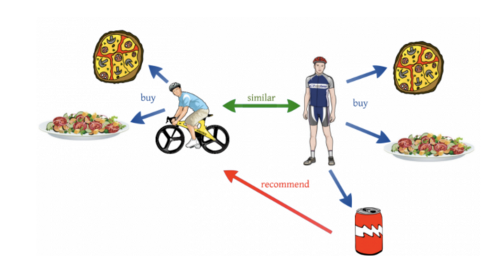
Collaborative Filtering
Collaborative filtering is a mathematical method/formula to find the predictions about how much a user can rate a particular item by comparing that user to all other users.
For example: To predict PersonA rating on a particular item, it would compute the similarity between PersonA with all users. Take the top users who are most similar to the PersonA, then it would compute the predicted ratings for PersonA items with respective to all similar users.

Slide 11
Why Collaborative Filtering?
It benefits from large user bases.
It’s flexible across different domains.
It produces the level of recommendations required.
It can capture more nuance around items.

Slide 12
Collaborative Filtering Process
Data Collection -> Data Processing -> Calculate Referrals -> Derive Results
Data collection: Collecting user behaviour and associated data items
Data processing: Processing the collected data
Recommendation Calculation: The recommended calculation method used to calculate referrals
Derive the result: Extract the similarity, sort it, and extract the top N to complete

Slide 13
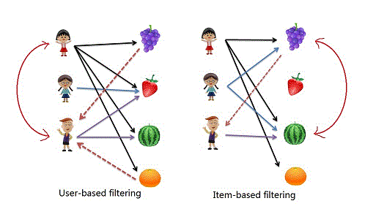
Memory-based Collaborative Filtering
Memory-based (neighbourhood approach) CF recommends items by finding similarity between users or items
User-based CF: To recommend items to a user based on another set of users with similar rating pattern to the user
Item-based CF: To recommend items with the most similarity with user’s other favourite items.
Similar users
Similar items
Notes:
There are two types of collaborative filtering.
First one is the user based filtering.
The second one is item based filtering.
User based filtering is essentially looking at how close is the subject to others.
You just look at that particular subject and try to make the profile of that subject and again try to make recommendation accordingly based on others.
Item based recommendation on the other hand is looking at the similar items that particular person have ever selected
and then try to do some similarity measure of that particular item to make recommendation accordingly.
So again everything is centred around the users or the user profile.
The user based filtering is looking at other users, how close they are to that subject.
The item based filtering is looking at the items that the user has ever selected and try to make similarity measure of that item to other items to make recommendations.
So these are the two types of collaborative filtering.

Slide 14
Collaborative Filtering – User based
It calculates the similarity between users to make implicit recommendation.
Steps:
Calculate the similarity between PersonA and all other users.
Predict the ratings of items for PersonA based on similar users.
Select top-N rated items for PersonA.
Similar users
Notes:
So lets use movie ratings as an example.
The steps involved in the calculation is:
Firstly, it calculates the similarity between PersonA and all other users. How similar person A and person B are for example.
And then, predict the ratings of movies for PersonA based on users similarity.
And finally, select the top-N rated movies for PersonA.
So in this case, its looking at what others have actually seen to make the recommendation of the movie.
Let me give you an example,
Imagine that we want to recommend a movie to our friend Paras.
We could assume that similar people will have similar taste.
Suppose that me and Paras have seen the same movies, and we rated them all almost identically.
But Paras hasn’t seen the movie ‘Inception’ and I did.
If I love that movie, it sounds logical to think that he will too.
With that, we have created an artificial rating based on our similarity.
So, the user based collaborative filtering uses that logic and recommends items by finding similar users to the active user to whom we are trying to recommend a movie.

Slide 15
Collaborative Filtering – Item based
It calculates the similarity between items to make implicit recommendation
.
Steps:
Calculate the similarity between any two items to get item-item similarity matrix.
Predict the ratings of items for PersonA based on similar items.
Select top-N rated items for PersonA.
Similar items
Notes:
Now for the item based collaborative filtering, it looks at the similarity of items that the user have selected earlier.
So if these two items are considered similar, it will provide recommendation accordingly.
So, the first one - User based is looking at the similarity of the users and second one – item based is looking at the similarity of the items that the user have ever selected in the past.
Lets go back to Paras.
Now, Instead of focusing on his friends, we could focus on
what items from all the options are more similar to what we know he enjoys.
Lets say Paras enjoys Iron Man, Bat Man and Hulk movies. We have other options Titanic, Green Lantern and The Avengers.
We can see that Green Lantern and The Avengers are similar to Iron Man, Bat Man and Hulk for example.
So we will recommend Green Lantern and The Avengers to Paras.
This new focus is known as Item-Based Collaborative Filtering (IB-CF).
https://towardsdatascience.com/comprehensive-guide-on-item-based-recommendation-systems-d67e40e2b75d

Slide 16
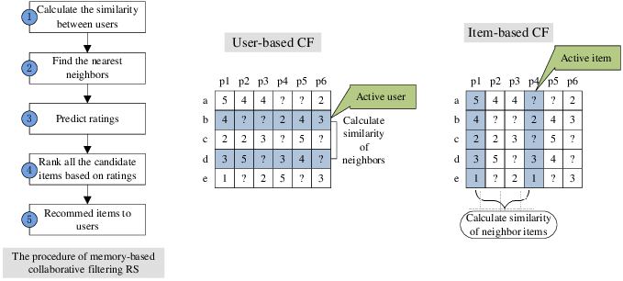
User-Based Vs Item-Based CF
For both user-based or item-based CF, the computation of similarity is based on the preference for the item.
The features used to calculate similarity can be user’s purchase frequency, user’s preference rating, number of product clicks, or a combination of all of these.
Adopted from paper ‘A Survey of Collaborative Filtering-Based Recommender Systems: From Traditional Methods to Hybrid Methods Based on Social Networks’

Slide 17
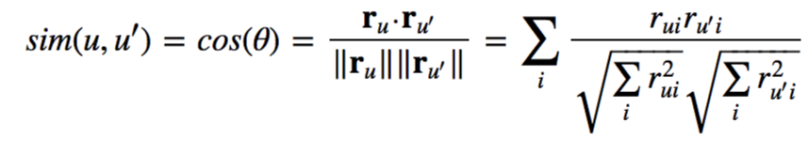
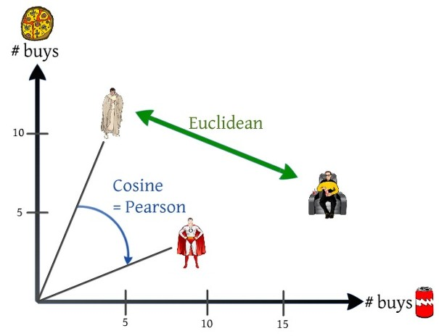
How to get similarity?
Cosine similarity:
Measures the cosine of the vector angle between ratings of two users
If cosine value is 1, two users are completely similar in their preference, if cosine value is -1, they are completely dissimilar
Similar to Pearson correlation, which measures correlation between two users
Euclidean distance:
Measures distance in rating/preference between two users
If the distance is small, two users have a similar preference (i.e., the similarity is high).
Notes:
What is it basically?
Euclidean distance is looking at the distance between person A and person B to do some selection or provide recommendation.
If the distance of the preference between the two users is small, that means the similarity is high.
And Pearson correlation, the cosine information is used to find the correlation between the two.
So if the cosine values coincide that means that the correlation is consistent.
These are the two method to calculate the similarity between the users.

Slide 18
Collaboration Filtering: Walkthrough Example
Name | Star Trek | Star wars | Superman | Batman | Hulk
Harry | 4 | 2 | ? | 5 | 4
John | 5 | 3 | 4 | ? | 3
Rob | 3 | ? | 4 | 4 | 3
Aim: Recommend top-2 movies to Harry

Slide 19

Collaboration Filtering: Walkthrough Example (user-based)
Step 1: Calculate the similarity between Harry and all other users
Name | Star Trek | Star wars | Superman | Batman | Hulk
Harry | 4 | 2 | ? | 5 | 4
John | 5 | 3 | 4 | ? | 3
Rob | 3 | ? | 4 | 4 | 3
Cosine similarity
$$r_{ui}$$
- value of ratings user u gives to item i

Slide 20
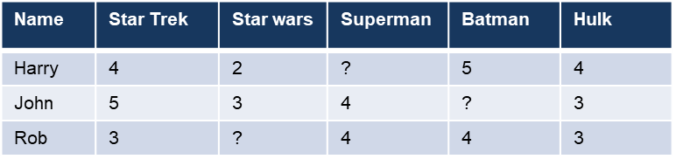
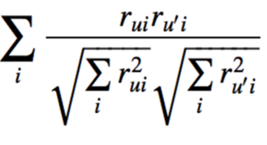





Collaboration Filtering: Walkthrough Example (user-based)
Step 1: Calculate the similarity between Harry and all other users
Cosine similarity
$$r_{ui}$$
- value of ratings user u gives to item i
= $0.97$
= $1.00$
Notes:
And then if we apply that formula in to this example, it will be like this.
Similarity between Harry and John.
It is a user based similarity, it looks at the rating provided by harry and john and exclude those that have missing information.
So in this case, 4 * 5 for star trek, 2 * 3 for star wars and 4 * 3 for hulk.
So that will be the nominator.
And then for the denominator, we will find the square root of the rating that is provided by Harry.
So it will be the combination of 4 square plus 2 square plus 4 square. Square root of that.
Times the square root of ratings provided by John.
5 square plus 3 square plus 3 square and Square root of that.
We exclude anything that is missing. So basically we include 3 movies here, star trek, star wars and hulk.
Based on this the similarity between harry and john is 0.97
Similarly for harry and Rob, it calculate the similarity of ratings.
So in this case, 4 * 3 for star trek, 5 * 4 for batman and 4 * 3 for hulk.
So that will be the nominator.
And then for the denominator, we will find the square root of the rating that is provided by Harry.
So it will be the combination of 4 square plus 5 square plus 4 square. Square root of that.
Times the square root of ratings provided by Rob.
3 square plus 4 square plus 3 square and Square root of that.
We exclude anything that is missing. So basically we include 3 movies here, star trek, superman and hulk.
The similarity of harry and rob is coincidently 1.

Slide 21



Collaboration Filtering: Walkthrough Example (user-based)
Step 2: Predict the ratings of movies for Harry
Predicted rating is calculated based on aggregation of some similar users' rating of the item
Name | Star Trek | Star wars | Superman | Batman | Hulk
Harry | 4 | 2 | ? | 5 | 4
John | 5 | 3 | 4 | ? | 3
Rob | 3 | ? | 4 | 4 | 3
with normalising factor
Calculate k as a normalising factor
k = $\frac{1}{(0.97+1)}$ = 0.51
R(Harry, Superman) = k*$\left((sim\left(Harry, John\right)∗R(John,Superman))+(sim\left(Harry, Rob\right)∗R(Rob,Superman)\right)$)
= $0.51(\left(0.97∗4\right)+\left(1 ∗4\right))$
= $4.02$
Notes:
And then the next step is to calculate the normalising factor K.
K is 1 over similarity of Harry and John plus similarity of harry and rob.
So, the value will be 0.51.
Now to calculate the rating of harry for superman, what it does is $\left((sim\left(Harry, John\right)∗R(John,Superman))+(sim\left(Harry, Rob\right)∗R(Rob,Superman)\right)$ times K the normalisation factor.
Based on this calculation, the rating is 4.02.
So this is the predicted rating for harry to superman (the missing one).
This is based on the similarity of Harry, to John and to Rob based on ratings across all of these 5 movies.
To improve the recommendation performance, normalization is always used as a basic component for the predictor models.

Slide 22
Collaboration Filtering: Walkthrough Example (user-based)
Step 3: Select top-2 rated movies for Harry
Name | Star Trek | Star wars | Superman | Batman | Hulk
Harry | 4 | 2 | 4.02 | 5 | 4
John | 5 | 3 | 4 | ? | 3
Rob | 3 | ? | 4 | 4 | 3
Top-2(Harry, movies)= Batman, Superman

Slide 23
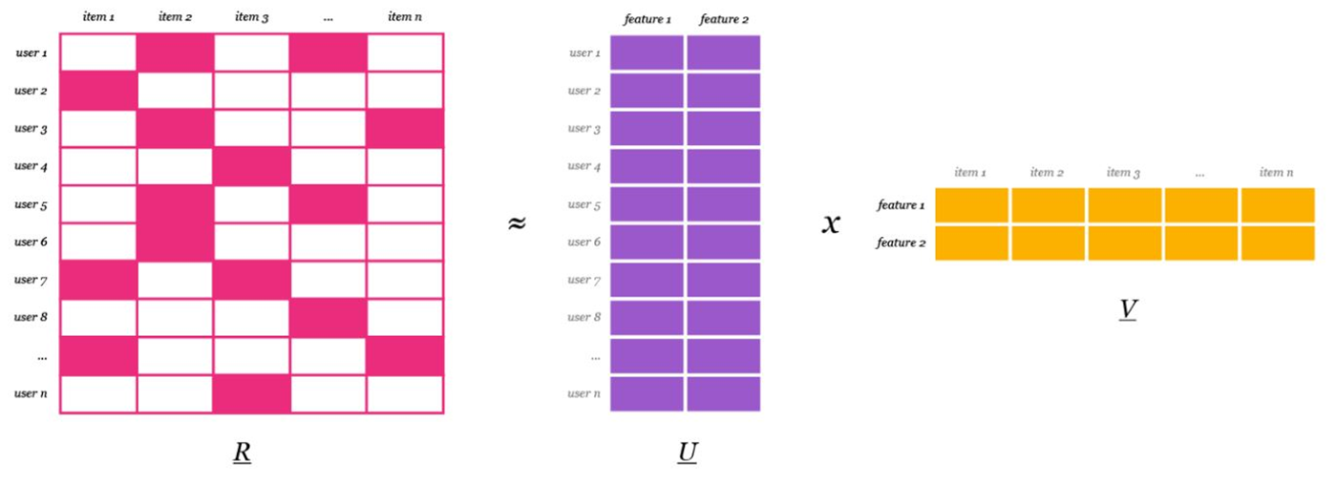
Model-based Collaborative Filtering
Latent factor model based CF learns the (latent) user and item profiles through matrix factorization
Matrix factorization: Factor a large matrix into some smaller representation of the original matrix through alternating least squares. The product of lower dimensional matrices equals the original one
Example: Factor the rating matrix R into user matrix U and item matrix V

Slide 24
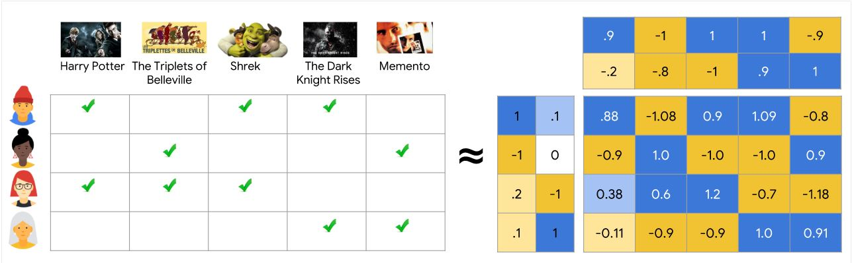



Alternating least squares
ALS method aims to estimate the user and item factor matrices (U & V) such that their product will approximate the original rating matrix R.
This is achieved by minimizing root mean square error (RMSE) between the original ratings and the predicted values
ALS Procedure:
Optimizing alternately to find U, V
Randomly initialize U and V
Iterating the following steps:
Fixing U → Optimizing V
Fixing V → Optimizing U
Each iteration will minimize the square errors
Rating matrix, R
User factor matrix, U
Item factor matrix, V
Predicted rating matrix $\hat{R}$
https://developers.google.com/machine-learning/recommendation/collaborative/matrix

Slide 25
Collaborative filtering in Spark
spark.ml currently supports model-based collaborative filtering, in which users and products are described by a small set of latent factors that can be used to predict missing entries.
spark.ml uses the Alternating Least Squares (ALS) algorithm to learn these latent factors.

Slide 26
Demo
MovieLens dataset consisting of a user, a movie, a rating and a timestamp.
Lets train an ALS model which assumes, by default, that the ratings are explicit.
And evaluate the recommendation model by measuring the root-mean-square error of rating prediction.

Slide 27
What have we learnt today?
Collaborative Filtering
Walkthrough examples and implementation in Apache Spark with Python

